Slide 1
Theory of Cost

Slide 2
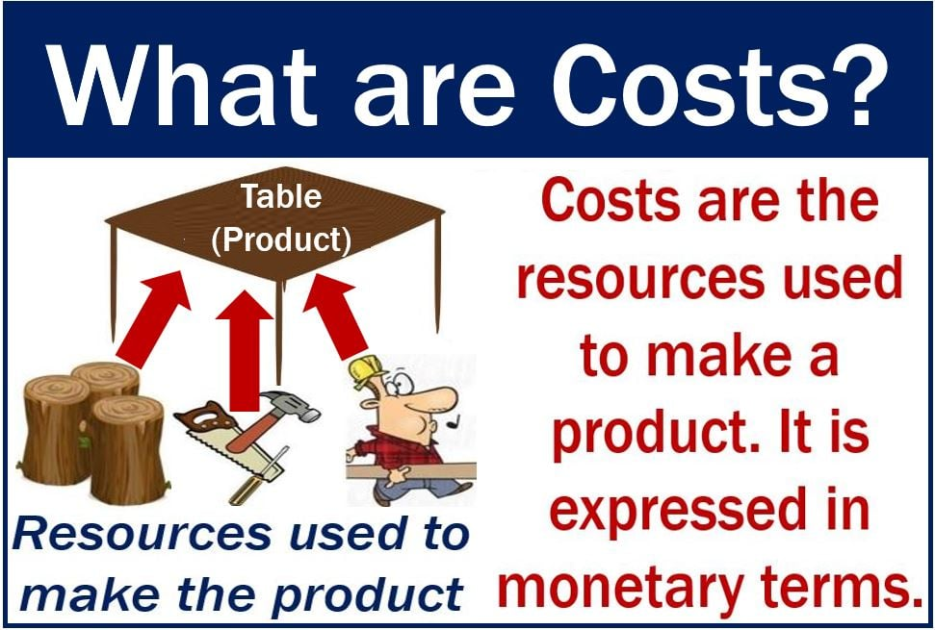
Notes:
Cost refers to the expenses incurred by a firm or producer in the process of creating and delivering goods or services. These costs are associated with the various inputs and resources used in the production process. Understanding production costs is crucial for businesses to make informed decisions about pricing, resource allocation, and overall profitability. For sellers, costs are how much money they spend producing a good. If they sold their products at the price of production, their costs and income would be the same. In other words, they would break even – they would neither make a profit nor a loss.
For buyers, a product’s cost is also the price. It is the amount the seller charges them for a product. It includes the production costs as well as the markup, which the seller adds to make a profit.

Slide 3
Types of Costs
Accounting Cost vs Economic Costs
Accounting costs are actual cost, also known as explicit costs, are costs that involve money being spent such as rent, utility bills, wages, interest payments.
Economic costs includes the cost incurred by the firm for utilizing economic resources in production, including opportunity costs
Notes:
Accounting costs and economic costs are two concepts used in economic analysis, and they differ in their scope and considerations.
Accounting Costs:
Definition: Accounting costs are the explicit, monetary costs incurred by a firm in its day-to-day operations. These costs are recorded in the company's financial statements.
Example: If a company spends 1000 rupees on raw materials, 5,000 on labor, and 2,000 on rent to produce a product, the accounting cost for that product would be 8000 rupees.
Economic Costs:
Definition: Economic costs encompass both explicit and implicit costs, including the opportunity costs associated with the use of resources. Opportunity costs are the benefits forgone by choosing one alternative over another.
Components: Economic costs include explicit costs (like accounting costs) plus implicit costs, which are the value of resources used in the firm's production that do not involve a direct cash outlay, such as the owner's time or the use of owned equipment.
Example: Continuing with the previous example, if the owner of the company works full-time in the business and foregoes a salary of 50,000 working elsewhere, the economic cost would be the sum of the explicit costs (8000) and the implicit cost (50,000), totaling 58,000 rupees.
In summary, while accounting costs focus on explicit monetary expenses recorded in financial statements, economic costs consider both explicit and implicit costs, providing a more comprehensive perspective on the true cost of resource utilization, including the value of forgone opportunities. Economic costs are often more relevant for decision-making and assessing the overall impact of choices on a firm's resources and profitability.
Implicit cost represents the opportunity costs associated with using resources that the firm already owns or employs.
Explicit cost- An explicit cost is a cost that is directly incurred by the firm, company or organization during the production. The explicit cost is kept on record by the accountant of the firm. Salaries, wages, rent, raw material are few example of the explicit cost. The explicit cost is also known as out- pocket cost. This cost is handy in calculating both accounting and economic profit.
Implicit cost
The implicit cost is directly opposite to it, as it is the cost that is not directly incurred by the firm or company. In implicit cost outflow of cash doesn’t take place. It is not in the record and is heard to be traced back. The interest on owner’s capital or the salary of the owner are the prominent example of the implicit cost. The implicit cost is also known as imputed cost. Through implicit cost , only the economic profit is calculated.

Slide 4
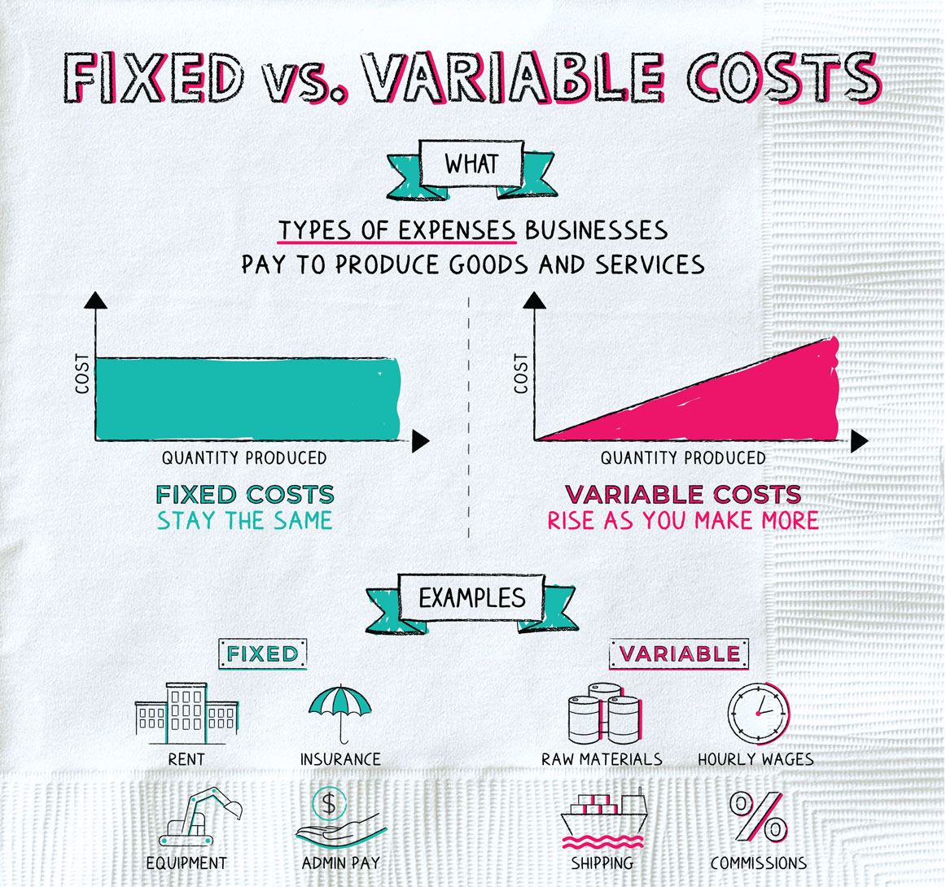
Notes:
Fixed Costs:
Definition: Fixed costs are expenses that do not vary with the level of production or sales. These costs remain constant regardless of the quantity of goods or services produced by a business in the short run.
Nature: Fixed costs are incurred even if the production level is zero, and they typically include items like rent, salaries of permanent staff, insurance, and machinery depreciation.
Example: Consider a manufacturing company that leases a production facility for 50,000 rupees per month. Whether the company produces 1,000 units or none at all, the rent expense remains fixed at 50,000 rupees per month.
Variable Costs:
Definition: Variable costs are expenses that change proportionally with the level of production or sales. These costs vary based on the quantity of goods or services produced.
Nature: Variable costs typically include items like raw materials, direct labor, and utilities directly associated with the production process.
Example: In the context of the manufacturing company, the cost of raw materials (e.g., steel, plastic, or electronic components) is a variable cost. If the company produces more units, the cost of raw materials increases accordingly.
Example Scenario: Let's assume the manufacturing company produces electronic gadgets. The monthly costs are as follows:
Fixed Cost: Rent for the production facility = rupees 50,000 per month (remains constant)
Variable Cost: Cost of raw materials per gadget = rupees10 (varies with production level)
If the company produces 500 gadgets, the total costs would be:
Fixed Costs = 50,000
Variable Costs = rupee10 per gadget * 500 gadgets = 5,000 rupees
The total cost (sum of fixed and variable costs) for producing 500 gadgets would be 55,000. If the production level increases or decreases, the fixed costs remain at 50,000, while the variable costs change accordingly based on the production volume.

Slide 5
Total Cost, Average Cost and Marginal Cost
1. Total cost- Total cost is the total expenditure incurred in the production of goods and services.
TC= TFC+TVC
2. Average cost- Average cost is not actual cost, It is obtained by dividing the total cost by the total output.
AC= Total Cost/Units Produced
3. Marginal cost- The cost incurred on producing one additional unit of commodity is known as marginal cost. Thus it shown a change in total cost when one more or less unit is produced.
MCn= (TC)n – TC(n-1 )
Notes:
1. Total cost is the overall expense incurred by a firm in producing a certain quantity of output.
It includes both fixed costs (costs that do not change with the level of production, such as rent and salaries) and variable costs (costs that vary with the quantity of output, such as raw materials and labor).
2. The additional cost incurred to the total cost when one more unit of output is produced is known as Marginal Cost. For example, if the total cost of producing 2 units is ₹400 and the total cost of producing 3 units is ₹600, then the marginal cost will be 600 – 400 = ₹200.
MC_{n} = TC_{n} – TC_{n-1}
When the change in the units produced is more than one unit, then the previous formula of calculating MC will not work. In that case, the formula for calculating Marginal Cost will be:
For example, if the total cost of producing 5 units is ₹700 and the total cost of producing 3 units is ₹250, then the marginal cost will be:
Marginal Cost = ₹225
3. ABC Furniture manufactures chairs, and they have a total cost of 20,000 for producing 200 chair
AC= TC/Q=20,000/200=100 per chair
Interpretation: The average cost of production for each chair at this level is 100 rupees. This means that, on average, ABC Furniture incurs 100 rupees in costs to produce a single chair, considering both fixed and variable costs. This average cost figure provides insight into the cost efficiency of producing chairs at this particular production level.

Slide 6
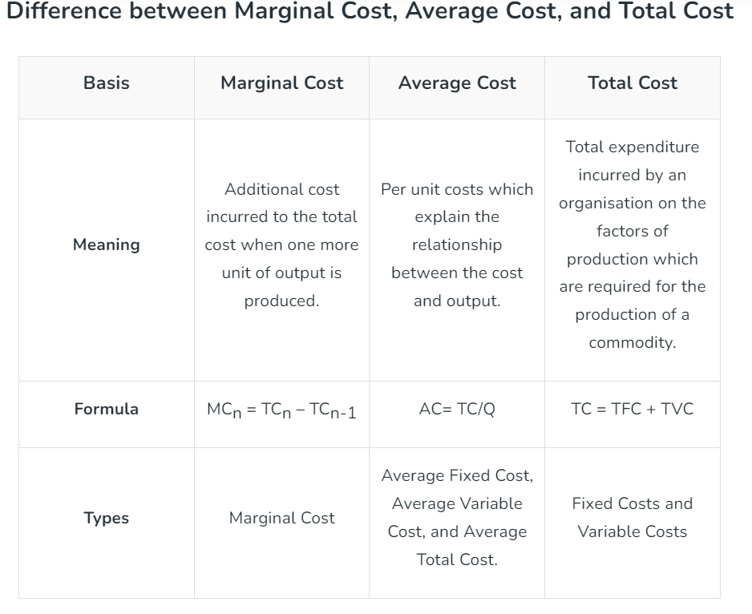

Slide 7
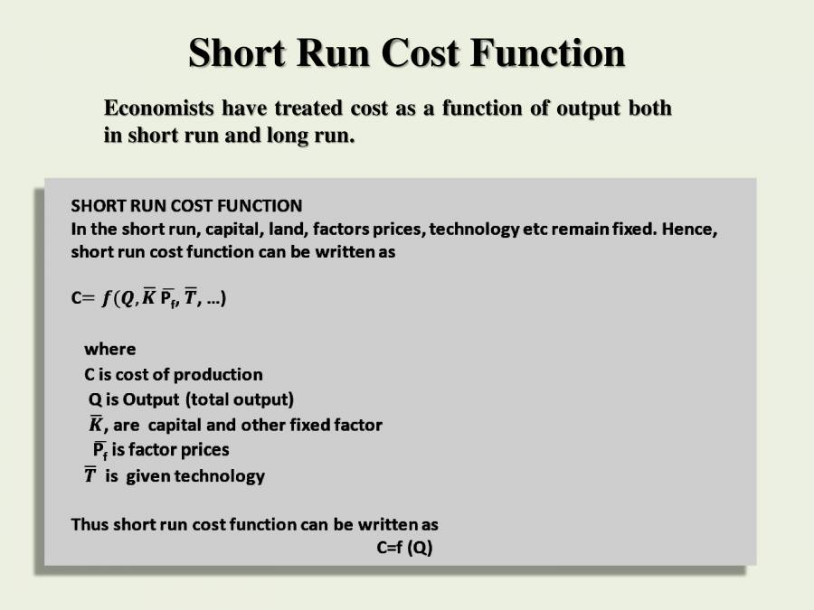
Notes:
Short run cost- Short run is a period where the time is too short to expand the size of industry and the increased demand has to be met within the existing size of industry because there are certain factors which cannot be changed in short run. So short run costs are those which vary with output when fixed plant a capital equipment remain unchanged.
For example- Let’s say a firm notice a sudden rise in demand for caps and it realizes that the only way to meet the additional demand in the short run is to change the temporary elements, like, the firm can hire more labors or buy raw materials in bulk, but the plant size or machinery cannot be changed to increase the firm’s production capacity of caps. As a result, the short-run cost includes all costs expended on variable components such as labour and raw materials.
The short-run cost varies with the change in total output from an analytical standpoint, while the firm’s size remains constant. As a result, the short-run cost is always considered a variable cost.
The cost output relationship plays an important role in determining the optimum level of production. TC=F(Q) Where, TC= Total cost Q= Quantity produced F= Function

Slide 8
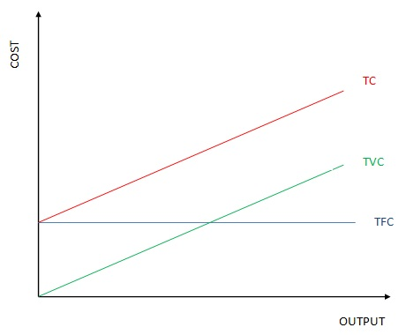
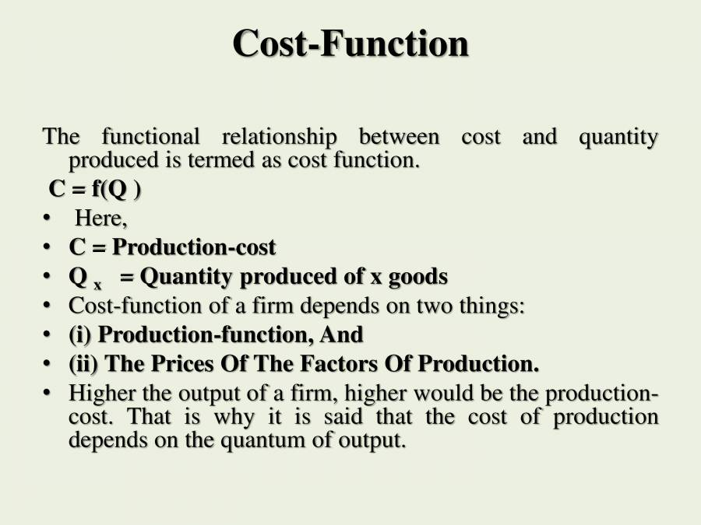
Short-Run Cost Function
Total Cost= Total Fixed Costs + Total Variable Costs
Notes:
Cost output relationship in short run. In the short-run a change in output is possible only by making changes in the variable inputs like raw materials, labour etc. Inputs like land and buildings, plant and machinery etc. are fixed in the short-run. It means that short-run is a period not sufficient enough to expand the quantity of fixed inputs. Thus Total Cost (TC) in the short-run is composed of two elements – Total Fixed Cost (TFC) and Total Variable Cost (TVC). TFC remains the same throughout the period and is not influenced by the level of activity. The firm will continue to incur these costs even if the firm is temporarily shut down. Even though TFC remains the same fixed cost per unit varies with changes in the level of output. On the other hand TVC increases with increase in the level of activity, and decreases with decrease in the level of activity. If the firm is shut down, there are no variable costs. Even though TVC is variable, variable cost per unit is constant. So in the short-run an increase in TC implies an increase in TVC only. Thus: TC = TFC + TVC ; TFC = TC – TVC ; TVC = TC – TFC; TC = TFC when the output is zero. The graph above shows Short-run cost output relationship.

Slide 9
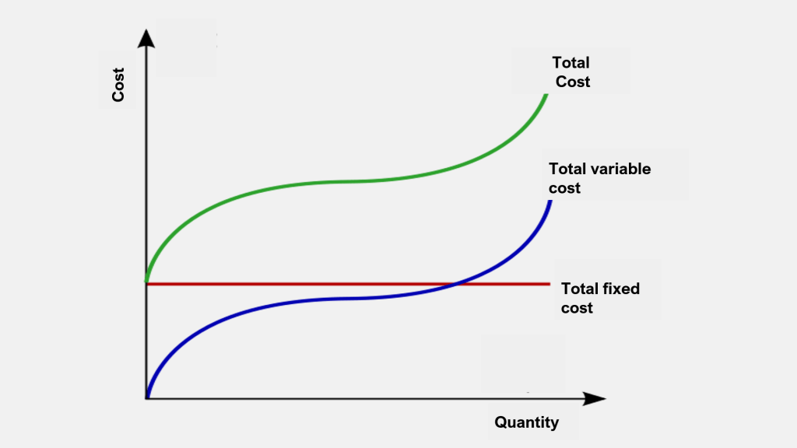
Total Cost Curve
Notes:
In the graph X-axis measures output and Y-axis measures cost. TFC is a straight line parallel to X-axis, because TFC does not change with increase in output. TVC curve is upward rising from the origin because TVC is zero when there is no production and increases as production increases. The shape of TVC curve depends upon the productivity of the variable factors. The TVC curve above assumes the Law of Variable Proportions, which operates in the short-run. TC curve is also upward rising not from the origin but from the TFC line. This is because even if there is no production the TC is equal to TFC. It should be noted that the vertical distance between the TVC curve and TC curve is constant throughout because the distance represents the amount of fixed cost which remains constant. Hence TC curve has the same pattern of behavior as TVC curve.

Slide 10
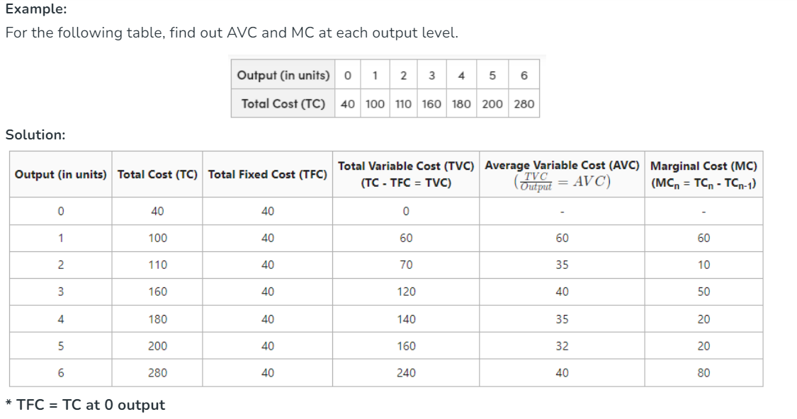

Slide 11
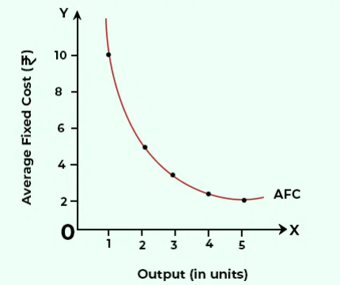
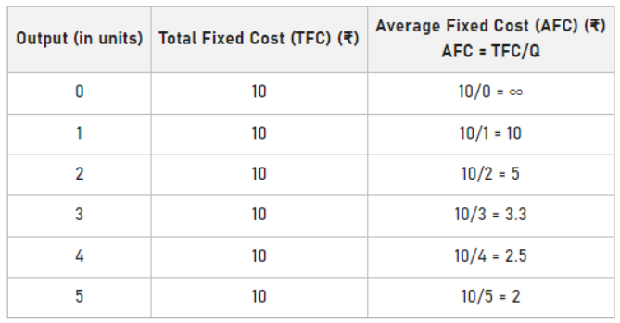
Average Fixed Cost Curve
Notes:
It can be seen in the above schedule that with the increase in output level, AFC falls. It is because the constant TFC; i.e., ₹10 is divided by the increasing output. In the above graph, the AFC curve is formed by plotting the points shown in the above schedule. AFC will keep on falling because of the increasing output level; however, it can never be equal to zero. Therefore, the AFC curve is a rectangular hyperbola. It means that AFC is a curve in which any rectangle formed under the curve will have the same area. Average Fixed Cost (AFC): Average fixed cost is obtained by dividing the TFC by the number of units produced. Thus: AFC = TFC/Q where, ‘Q’ refers quantity of production. Since TFC is constant for any level of activity, fixed cost per unit goes on diminishing as output goes on increasing. The AFC curve is downward sloping towards the right throughout its length, with a steep fall at the beginning.
AFC curve does not touches X-axis and Y-axis.
AFC is a rectangular hyperbola and hence approaches both the axes. The curve gets near to the axes, but never touches them. It means that AFC can neither touch X-axis (because TFC can never be zero) nor Y-axis (because TFC is positive at zero output level and if we divide any value by zero, it will be an infinite value).

Slide 12
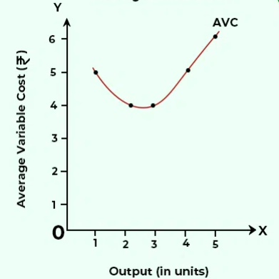
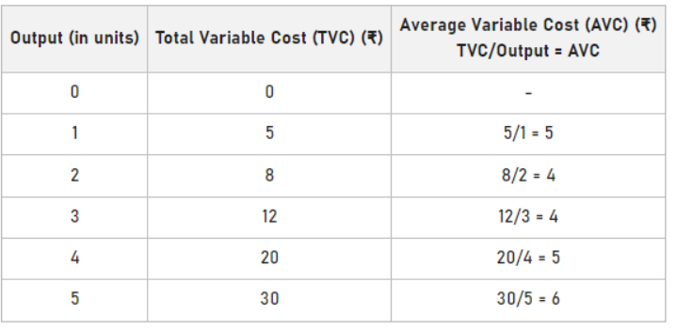
Average Variable Costs
Notes:
Total Variable Cost (TVC) increases as the quantity of output or production increases. This is due to the fact that variable costs are directly linked to the level of production. Variable costs change in proportion to the changes in the level of output, and they do not exist when there is no production.
The formula for Total Variable Cost TVC=VC×Q
where: TVC is the total variable cost.
VC is the variable cost per unit of output.
Q is the quantity of output.
The increase in Total Variable Cost can be attributed to a few reasons:
Higher Production Levels: As the quantity of output (�Q) increases, the total variable cost (���TVC) will increase proportionally, assuming the variable cost per unit (��VC) remains constant. This is because more units of the variable input (e.g., labor, raw materials) are required to produce a greater quantity of output.
Diminishing Marginal Returns: In the short run, there may be a point where the Law of Diminishing Marginal Returns comes into play. As more units of a variable input are added to a fixed quantity of other inputs, the additional output produced by each additional unit of the variable input may diminish. This can lead to an increase in variable costs per unit, contributing to a rise in Total Variable Cost.
Variable Input Costs: If the cost per unit of the variable input increases (e.g., wages or raw material prices go up), it will directly impact the Total Variable Cost. The increase in the cost of variable inputs raises the cost associated with producing each additional unit of output.
It's important to distinguish between variable costs and fixed costs. Variable costs change with the level of production, while fixed costs remain constant regardless of the quantity produced. The sum of variable and fixed costs gives the Total Cost.

Slide 13
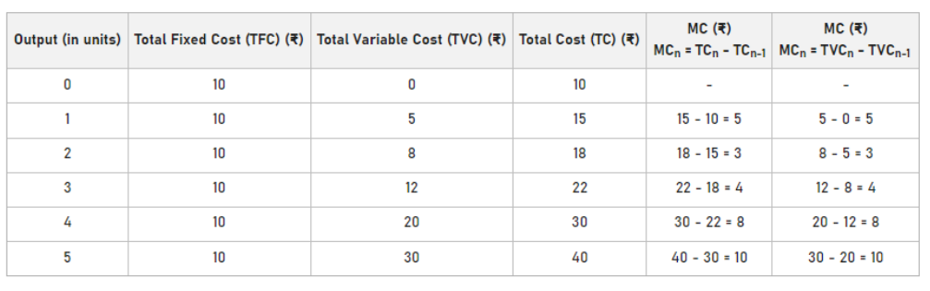
Marginal Cost
Notes:
Marginal Cost is the additional cost to Total Cost when one more unit of the output is produced. Also, TC is the sum of TFC and TVC. Now, as TFC does not change with the change in output, Marginal Cost is independent of Total Fixed Cost and is affected by TVC only.

Slide 14
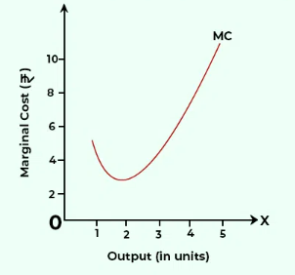
Marginal Cost Curve
MC is a U-shaped curve because of the Law of Variable Proportions.
In the beginning, the units of the variable factor are employed along with the fixed factors, yielding increasing returns to factor and reducing MC. It pushes down the MC curve. When more variable factors are employed, it results in diminishing returns and increasing MC after it reaches its minimum level.
Notes:
In the beginning, the units of the variable factor are employed along with the fixed factors, yielding increasing returns to factor and reducing MC. It pushes down the MC curve. Now, when more variable factors are employed, it results in diminishing returns and increasing MC after it reaches its minimum level. Therefore, the MC curve falls to its minimum level and then increases, making the short-run MC curve, U-shaped.

Slide 15
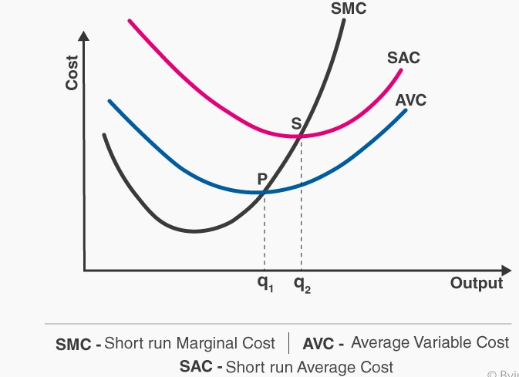
Short-Run Cost Curves
Notes:
Average Variable Cost (AVC): Average Variable Cost is obtained by dividing the TVC by the number of units produced. Therefore: Due to the operation of the Law of Variable Proportions AVC curve slopes downwards till it reaches a certain level of output and then begins to rise upwards. Average Total Cost (ATC): Average Total Cost or simply Average Cost is obtained by dividing the TC by the number of units produced. Thus: AVC = TVC / Q ATC = TC / Q The ATC curve is very much influenced by the AFC and AVC curves. In the beginning both AFC curve and AVC curve decline and therefore ATC curve also declines. The AFC curve continues the trend throughout, though at a diminishing rate. AVC curve continues the trend till it reaches a certain level and thereafter it starts rising slowly. Since this rise initially is at a rate lower than the rate of decline in the AFC curve, the ATC curve continues to decline for some more time and reaches the lowest point, which obviously is further than the lowest point of the AVC curve. Thereafter the ATC curve starts rising because the rate of rise in the AVC curve is greater than the rate of decline in the AFC curve. Marginal Cost (MC): Marginal Cost is the increase in TC as a result of an increase in output by one unit. In other words it is the cost of producing an additional unit of output. MC is based on the Law of Variable Proportions. A downward trend in MC curve shows decreasing marginal cost (i.e. increasing marginal productivity) of the variable input. Similarly an upward trend in MC curve shows increasing marginal cost (i.e. decreasing marginal productivity). MC curve intersects both AVC and ATCcurves at their lowest points.
The relationship between AVC, AFC, ATC and MC can be summed up as follows. 1. If both AFC and AVC fall ATC will also fall because ATC = AFC + AVC 2. When AFC falls and AVC rises (a) ATC will fall where the drop in AFC is more than the rise in AVC (b) ATC remains constant if the drop in AFC = the rise in AVC, and (c) ATC will rise where the drop in AFC is less than the rise in AVC. 3. ATC will fall when MC is less than ATC and ATC will rise when MC is more than ATC. The lowest ATC is equal to MC.

Slide 16
Long-Run Cost function
In the long –run, a firm can amend its size and organization to meet up with the demand conditions.
Firms can adjust its scale of operations or size of plant to produce any required output in the most efficient way.
In short, all the factors are variable in the long run and therefore, the scale of operation can be altered.
The long run cost output relation is influenced by Law of Returns to Scale.
Notes:
In order to study the cost output relationship in the long run it is necessary to know the meaning of long run. As known in the long run the size of an industry can be expanded to meet the increased demand for products as such in the long run all the factors of production can be varied according to the need. Hence long run costs are those which vary with output when all the input factors including plant and equipment vary.
The long run refers to that time period for a firm where it can vary all the factors of production. Thus, the long run consists of variable inputs only, and the concept of fixed inputs does not arise. The firm can increase the size of the plant in the long run. Thus, you can well imagine no difference between long-run variable cost and long-run total cost, since fixed costs do not exist in the long run.

Slide 17
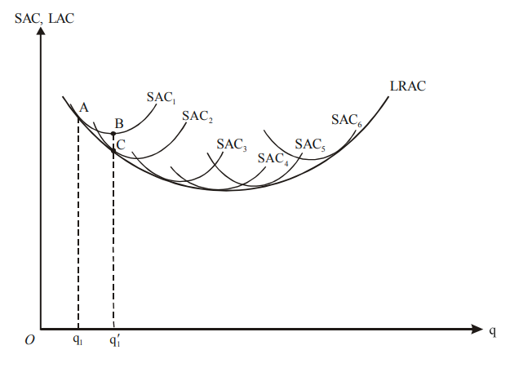
Long Run Average Cost Curve
Notes:
In the long run, all inputs are variable, and a firm can have a number of alternative plant sizes and levels of output that it wants. There are no fixed cost functions (total or average) in the long run, since no inputs are fixed. A useful way of looking at the long run is to consider it a planning horizon. The long run cost curve is also called planning curve because it helps the firm in future decision-making process.
The long run cost output relationship can be shown with the help of a long run cost curve. The long run average cost curve (LRAC) is derived from short run average cost curves (SRAC). To derive the LRAC, let us consider six plants at the manager’s disposal. These are represented by SCA1, SAC2, SAC3, SAC4, SAC5 and SAC6 as shown in Figure.
Suppose the manager of the firm thinks producing output OQ1 would be the most profitable. In such a case, plant 1 with average cost curve SAC1 would be constructed to produce OQ1. With this plant if output is expanded to OQ1’ then unit cost would fall; because then plant 1 would have been operated at the minimum point (which is shown by point B). Let this level of output be produced at a lower cost (represented by point C) from plant 2. By similar logic, we can see that as output rises, it would be most efficiently (i.e., at lower cost) produced from newly set up plants. The long-run planning curve, LAC, is a locus of points representing the least unit cost of producing the corresponding output. LAC is, therefore, an “envelope” curve of the SCAs. An interesting point to note here it that at point B, Plant 1 is being most efficiently operated. Yet it pays the manager to shift to plant 2. This is because unit cost is lower at point C than at point B, even though C is not the most efficient point for plant 2. In fact, all plants smaller than type 4 are only used when they are operating at less than the efficient level. Therefore, it is not efficiency for a given plant that matters, but efficiency overall. The LAC is the locus of points with minimum unit cost associated with a particular level of output with respect to all available plants.

Slide 18
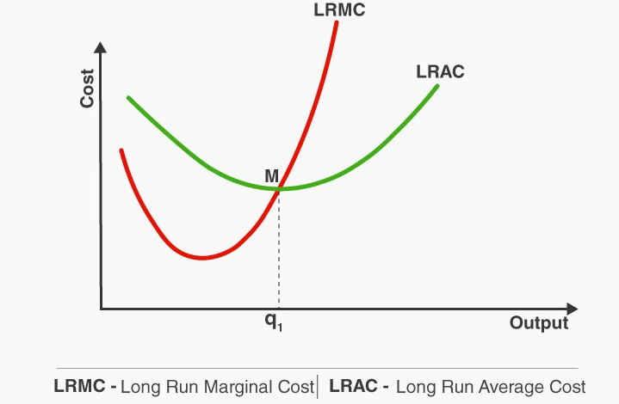
Long Run Cost Curves

Slide 19
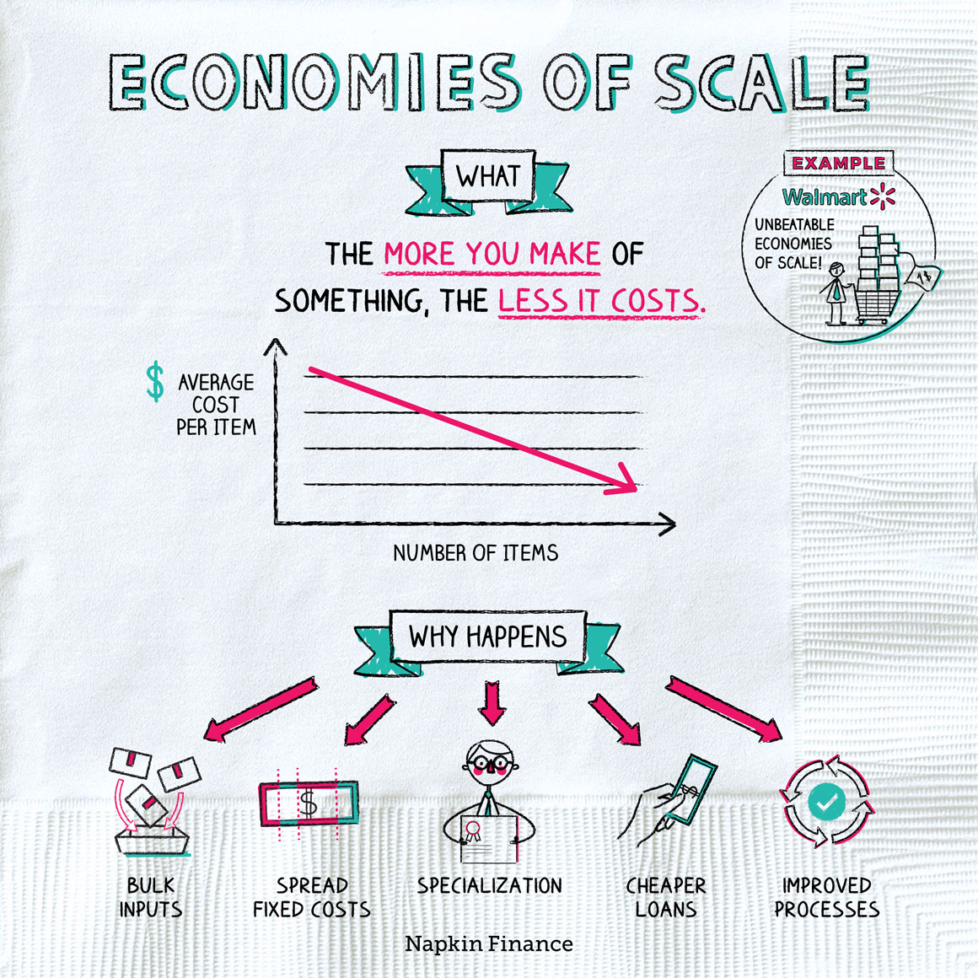
Notes:
Economies of scale occur when it’s cheaper to produce a lot of something than it is to produce a little of something. (That is, cheaper on a per-unit basis.)
How it works
Suppose you wanted to make a smartphone. You’d need to hire a team of tech experts to design it, buy specialized high-tech materials to make it from, build or buy some machinery, and pay workers to assemble the phone correctly.
Now suppose, instead, you wanted to make 100,000 smartphones. The cost of designing the phones and acquiring the machinery might be about the same as if you were making just one. You’d need to pay more in total for materials and assembly labor—but because you could buy those in bulk, you’d probably get a better rate. All in all, the cost per phone would be much lower than if you were making just one.
Why it happens
Economies of scale can flow from a number of sources:
Buying inputs in bulk
Just like when you go to Costco, buying more of something typically means you pay less per item.
That means a smartphone maker can pay less per battery, for example, if it buys 100,000 batteries instead of just one.
Spreading out fixed costs
Fixed costs are expenses that don’t change with output—they stay the same no matter how much you produce.
Suppose it costs $1 million to design the smartphone:
Making 1 phone → design costs = $1 million per phone
Making 100,000 phones → design costs = $10 per phone
Specialization
When workers have a particular area of expertise, they can do that job faster and more efficiently.
It’s more efficient to have one worker who’s an expert in assembling the phone and another who’s an expert in programming the phone than it is to have one person who tries to do everything.
Cheaper financing
A big, stable company can typically borrow money at lower rates than a small, less-established company.
Gains in knowledge and expertise
Companies that produce a lot of something can learn from their mistakes and improve their process. That results in further cost savings.
Good or bad?
In the big picture, economies of scale boost economic growth, which means the world economy as a whole is typically better off for it. But just like other economic forces, economies of scale can have complex consequences—some of which are controversial.
Here are two ways economies of scale can create virtuous circles:
Goods become cheaper ↓ People spend less to buy the things they need ↓ People have more money left over ↓ Better quality of life
People buy more stuff total-Companies produce more-Companies hire more workers-More people have jobs, and the economy grows more
And here are two ways economies of scale can have negative impacts:
Companies become very big and powerful-Powerful companies pay workers and suppliers less-Hurts those workers and suppliers
Countries’ economies become very specialized-Those countries have to buy a lot of what they need from other countries-Economy is less diversified and stable
To illustrate the last point: Suppose a country’s economy becomes highly specialized in one thing—such as producing oil. That might mean it doesn’t produce much of its own food or medicine and instead buys those things from other countries.
That strategy might work fine as long as the global economy is running smoothly. But if the oil market hits a bump (say, because prices drop), or if there’s a disruption in global trade, the country could suddenly be unable to access enough food or medicine for its people.
Conclusion
Economies of scale describe how it’s often cheaper, per unit, to produce a lot of something than it is to produce a little of something—due to factors such as specialization and buying inputs in bulk. In general, economies of scale boost economic growth, which means more people have jobs, and there’s more money all around. But economies of scale can also have negative consequences if they lead to workers earning less money or cause an economy to overspecialize.
Fun facts
Wal-Mart is arguably the poster child of economies of scale. Because it’s so huge, it can buy its inventory at insanely cheap prices from its suppliers (which is how it can afford to offer insanely cheap prices in its stores). But it’s also controversial for how little it pays its employees and suppliers.
There can also be “diseconomies of scale,” which occur when costs start to go up as a company produces more. As companies grow bigger, they can also become harder to manage, which can lead to declining efficiency.
Key takeaways
Just as it’s cheaper, per roll, to buy 20 rolls of toilet paper than it is to buy one, it’s usually cheaper, per unit, to produce a lot of something than it is to produce a little.
Economies of scale can occur because it’s cheaper for companies to buy inputs in bulk, because they can spread out their fixed costs over a greater volume of production, and because they can obtain financing more cheaply as they grow, among other reasons.
Although economies of scale are generally good for the economy in the big picture, they can also have negative effects if individual companies become too powerful or if economies become overly specialized.

Slide 20
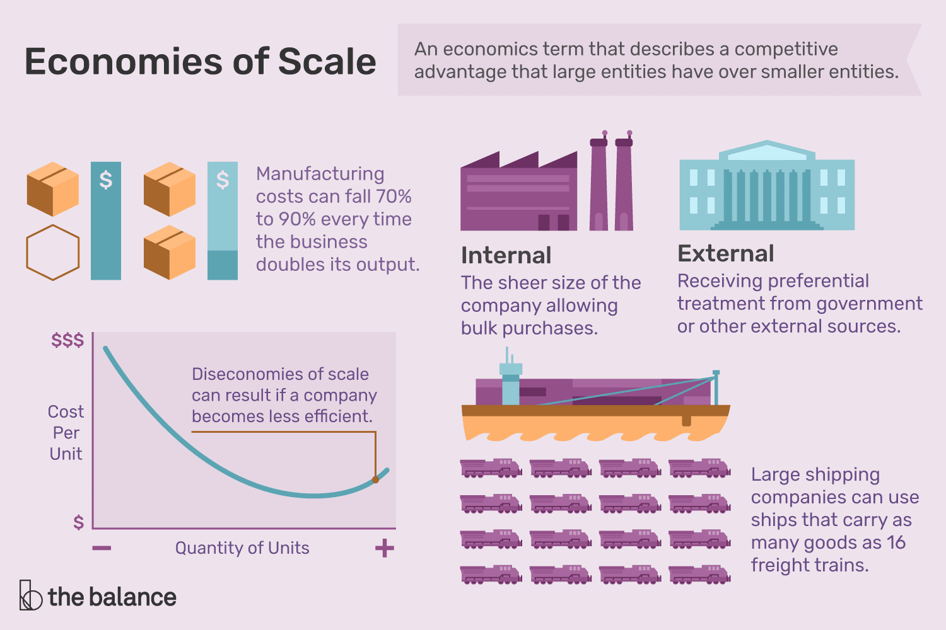
Notes:
Economies of scale are cost reductions that occur when companies increase production. The fixed costs, like administration, are spread over more units of production. Sometimes, a company that enjoys economies of scale can negotiate to lower its variable costs, as well.
Definition and Examples of Economies of Scale
Any time a company can decrease costs by increasing the volume of goods they produce, that's an example of an economy of scale.¹ There are several reasons why the costs of production would decrease as volume increases.
For example, by keeping a production line focused on one product, companies may save on the costs associated with swapping out raw materials and tools to produce different products. The most basic examples are managerial and administrative costs—you don't have to hire more managers just because your workers start producing more items per day.
Diseconomies of Scale
Sometimes a company chases economies of scale so much that it becomes too large. This overgrowth is called a diseconomy of scale. There comes a point at which maximum efficiency has been reached. Any units produced after that will increase production costs per unit, rather than decrease them.
Diseconomies of scale aren't always tied to physical production efficiencies. For example, it might take longer to make decisions, making the company less flexible. Miscommunication could occur, especially if the company becomes global. Acquiring new companies could result in a clash of corporate cultures. This clash will slow progress if they don't learn to manage cultural diversity.
How Economies of Scale Work
The specific way an economy of scale works depends on the goods or services being produced. It may be as simple as extending operating hours to get more use out of expensive machinery. Any way that a company can improve the per-unit cost by producing more units, that is how economies of scale work.
Economies of scale not only benefit the organization that produces the goods. Consumers can enjoy lower prices. The economy grows as lower prices stimulate increased demand.
Note
Economies of scale also give a competitive advantage to large entities over smaller ones. The larger the business, non-profit, or government, the lower its per-unit costs.
How to Make Economies of Scale Work for You
You don't have to be a corporation to benefit from economies of scale. Think of it like how larger families typically buy in bulk. Each box of detergent costs less per wash because you can buy it in bulk. The manufacturer saves on packaging and distribution. It then passes the savings onto you. You also save on travel costs by making fewer trips to the store.
Note
Governments and non-profits can also benefit from economies of scale. These benefits occur whenever an entity produces more, becomes more efficient, and lowers costs as a result.
Economies of Scope
Economies of scope are similar to economies of scale, but they occur when a company branches out into multiple product lines to combine efficiencies and business functions. For example, most newspapers diversified into similar product lines, such as magazines and online news. In other words, economies of scale focus on one product (volume), while economies of scope involve many products (variety).²
Types of Economies of Scale
There are two main types of economies of scale: internal and external. Internal economies are controllable by management because they are internal to the company. External economies depend upon external factors. These factors include the industry, geographic location, or government.
Internal economies result from a larger volume of production. There are five types of internal economies of scale. You'll typically see them in large organizations.
For example, large companies can buy in bulk. This economy lowers the cost per unit of the materials they need to make their products. They can use the savings to increase profits. Or they can pass the savings to consumers and compete on price.
Technical Economies of Scale
Technical economies of scale result from efficiencies in the production process itself. Manufacturing costs fall 70% to 90% every time the business doubles its output.³ Larger companies can take advantage of more efficient equipment.
For example, data mining software allows the firm to target profitable market niches. Large shipping companies cut costs by using super-tankers. Finally, large companies achieve technical economies of scale because they learn by doing. They’re far ahead of their smaller competition on the learning curve.
Monopoly Power
Monopsony power is when a company buys so much of a product that it can reduce its per-unit costs. For example, Wal-Mart can undercut smaller competitors by wielding its huge buying power.
Managerial Economies of Scale
Managerial economies of scale occur when large firms can afford specialists. They more effectively manage particular areas of the company. For example, a seasoned sales executive has the skill and experience to take care of big orders. They demand a high salary, but they're worth it.
Financial Economies of Scale
Financial economies of scale mean the company has cheaper access to capital. A larger company can get funded from the stock market with an initial public offering. Big firms have higher credit ratings and can offer lower interest rates on their bonds
Network Economies of Scale
Network economies of scale occur primarily in online businesses. It costs almost nothing to support each additional online customer with existing digital infrastructure. So, any revenue from the new customer is all profit for the business.
External Economies of Scale
A company has external economies of scale if its size creates preferential treatment. That most often occurs with governments.
For example, a state often reduces taxes to attract the companies that provide the most jobs. Big real estate developers convince cities to build roads to support their buildings, and this saves developers on those infrastructure costs. Large companies can also take advantage of joint research with universities to reduce research expenses.
Small companies don't have the leverage to benefit from external economies of scale, but they can band together. Small companies can cluster similar businesses in a small area.⁴ That allows them to take advantage of geographic economies of scale. For example, artist lofts, galleries, and restaurants benefit by being together in a downtown art district.
Key Takeaways
Economies of scale occur when a company’s production increases in a way that reduces per-unit costs.
Internal economies of scale can result from technical improvements, managerial efficiency, financial ability, monopsony power, or access to large networks.
External economies of scale are ones in which companies can influence economic priorities, often leading to preferential treatment by governments.
Diseconomies of scale can occur when a company increases production past the peak level of efficiency and the per-unit costs begin increasing.

Slide 21
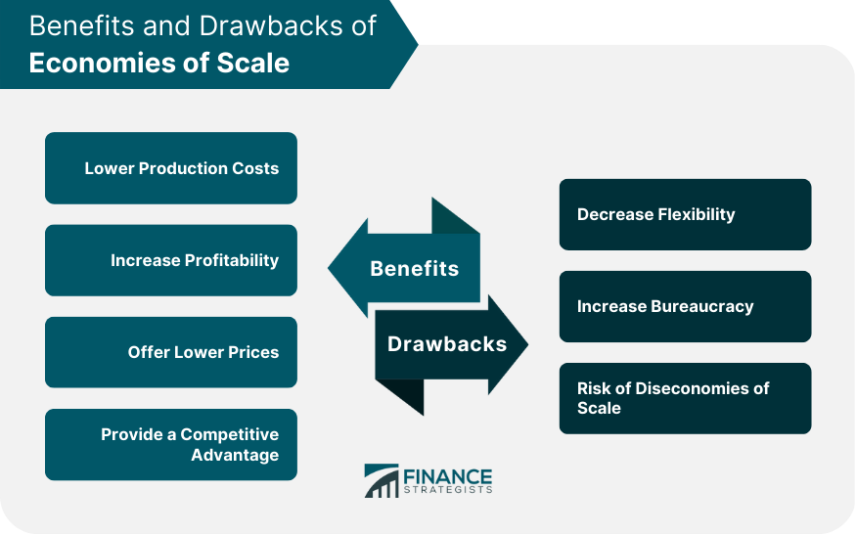
Notes:
Economies of scale refer to the cost advantages that a business or organization can achieve as it increases the scale of its operations. In simpler terms, the more a company produces, the lower the cost per unit.
This is because fixed costs, such as rent and salaries, can be spread out over a larger output, leading to lower average costs incurred by small businesses
Economies of scale can be achieved in various ways, including the use of specialized equipment, negotiating better prices for raw materials, and spreading advertising and marketing costs over a larger output.
Economies of scale can offer numerous benefits to businesses looking to scale up and improve profitability. These benefits include:
Lower Production Costs: As mentioned earlier, economies of scale can help businesses reduce their production costs per unit, which can lead to higher profits or lower prices for customers.
Increase Profitability: By reducing costs and increasing efficiency, economies of scale can help businesses achieve higher profits over the long term.
Offer Lower Prices to Customers: When businesses achieve economies of scale, they can pass the savings on to customers in the form of lower prices, which can help them compete more effectively in the market.
Provide a Competitive Advantage: Businesses that achieve economies of scale may be able to offer a wider range of products or services at lower prices than their competitors, which can give them a competitive advantage.
Drawbacks of Economies of Scale
While economies of scale can offer significant benefits, there are also some drawbacks that businesses should consider before scaling up. These include:
Decrease Flexibility: As businesses become larger, they may become less flexible and more bureaucratic, making it harder to adapt to changing market conditions or customer needs.
Increase Bureaucracy: As businesses grow, they may need to introduce more processes and procedures to manage the increased complexity, which can lead to increased bureaucracy and reduced efficiency.
Risk of Diseconomies of Scale: In some cases, businesses may experience diseconomies of scale, which occur when the costs of production per unit start to increase as output increases.
Factors Influencing Economies of Scale
Economies of scale can offer significant benefits to businesses, including lower production costs, increased profitability, and competitive advantage. However, the degree to which a business can achieve economies of scale depends on several factors.
Organization Size
The size of the organization is one of the most important factors influencing economies of scale. Generally, the larger the organization, the more likely it is to achieve economies of scale.
This is because fixed costs, such as rent, salaries, and utilities, can be spread out over a larger output, leading to lower average costs. Larger organizations may also have more bargaining power with suppliers and lenders, which can help them negotiate better prices and terms.
However, it is important to note that there are limits to how large an organization can grow before it starts to experience diseconomies of scale. Diseconomies of scale occur when the costs of production per unit start to increase as output increases.
This can happen if the business becomes too large to manage effectively or if there are inefficiencies in the production process.
Technology
The use of advanced technology and production techniques can help businesses achieve economies of scale more easily.
For example, a manufacturing company may invest in high-capacity production equipment that can produce more goods in a shorter time, resulting in lower costs per unit.
Similarly, a software company may develop an automated system for testing and debugging code, which can reduce the time and effort required for quality assurance.
The adoption of new technology can also help businesses improve efficiency and reduce waste. For example, a company may use software to automate inventory management or production scheduling, which can help it reduce its costs and improve its overall performance.
Industry Structure
Some industries are more conducive to achieving economies of scale than others. Industries with high fixed costs, such as manufacturing, may be more likely to achieve economies of scale.
This is because fixed costs can be spread out over a larger output, leading to lower average costs.
However, other industries, such as consulting or professional services, may be less conducive to achieving economies of scale.
This is because these industries often require highly skilled professionals who cannot be easily replaced, and the services they provide may be highly customized to individual clients.
Market Demand
The level of demand for a product or service can affect the degree to which a business can achieve economies of scale.
If demand is high, the business may be able to achieve economies of scale more easily. This is because it can sell more products or services, which can help it spread out its fixed costs over a larger output.
However, if demand is low or unpredictable, the business may struggle to achieve economies of scale. This is because it may not be able to sell enough products or services to spread out its fixed costs, leading to higher average costs per unit.

Slide 22
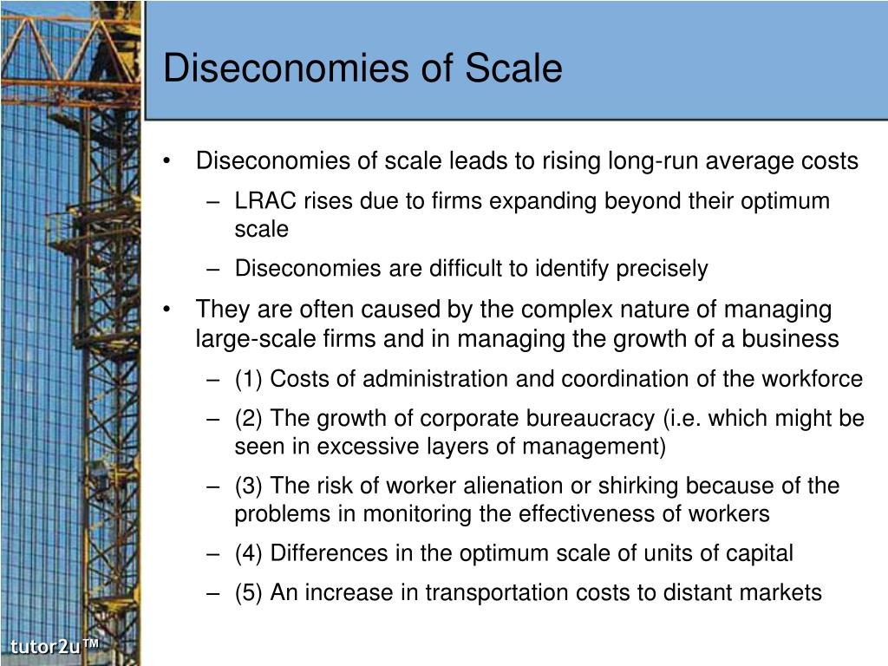
Notes:
Diseconomies of scale happen when a company or business grows so large that the costs per unit increase. It takes place when economies of scale no longer function for a firm. With this principle, rather than experiencing continued decreasing costs and increasing output, a firm sees an increase in costs when output is increased.
Diseconomies of scale occur when the expansion of output comes with increasing average unit costs.
Diseconomies of scale can involve factors internal to an operation or external conditions beyond a firm's control.
Diseconomies of scale may result from technical issues in a production process, organizational management issues, or resource constraints on productive inputs.
Diseconomies of scale specifically come about due to several reasons, but all can be broadly categorized as internal or external. Internal diseconomies of scale can arise from technical issues of production or organizational issues within the structure of a firm or industry.
External diseconomies of scale can arise due to constraints imposed by the environment within which a firm or industry operates. Essentially, diseconomies of scale are the result of the growing pains of a company after it's already realized the cost-reducing benefits of economies of scale.
The first is a situation of overcrowding, where employees and machines get in each other's way, lowering operational efficiencies. The second situation arises when there is a higher level of operational waste, due to a lack of proper coordination. The third reason for diseconomies of scale happens when there is a mismatch in the optimum level of outputs within different operations.
Types of Diseconomies of Scale
Internal diseconomies of scale involve either technical constraints on the production process that the firm uses or organizational issues that increase costs or waste resources without any change to the physical production process.
Technical Diseconomies of Scale
Technical diseconomies of scale involve physical limits on handling and combining inputs and goods in process. These can include overcrowding and mismatches between the feasible scale or speed of different inputs and processes.
An overcrowding effect within an organization is often the leading cause of diseconomies of scale. This happens when a company grows too quickly, thinking that it can achieve economies of scale in perpetuity. If, for example, a company can reduce the per-unit cost of its product each time it adds a machine to its warehouse, it might think that maxing out the number of machines is a great way to reduce costs.
However, if it takes one person to operate a machine, and 50 machines are added to the warehouse, there is a good chance that these 50 additional employees will get in each other's way and make it harder to produce the same level of output per hour. This increases costs and decreases output.
Sometimes, diseconomies of scale happen within an organization when a company's plant cannot produce the same quantity of output as another related plant. For example, if a product is made up of two components, gadget A and gadget B, diseconomies of scale might occur if gadget B is produced at a slower rate than gadget A. This forces the company to slow the production rate of gadget A, increasing its per-unit cost.
Organizational Diseconomies of Scale
Organizational diseconomies of scale can happen for many reasons, but overall, they arise because of the difficulties of managing a larger workforce. Several problems can be identified with diseconomies of scale.
First, communication becomes less effective. As a business expands, communication between different departments becomes more difficult. Employees may not have explicit instructions or expectations from management. In some instances, written communication becomes more prevalent over face-to-face meetings, which can lead to less feedback.
Another drawback to diseconomies of scale is motivation. Larger businesses can isolate employees and make them feel less appreciated, which can result in a drop in productivity.
External Diseconomies of Scale
External diseconomies of scale can result from constraints of economic resources or other constraints imposed on a firm or industry by the external environment within which it operates. Typically, these include capacity constraints on common resources and public goods or increasing input costs due to price inelasticity of supply for inputs.
External capacity constraints can arise when a common pool resource or local public good cannot sustain the demands placed on it by increased production. Congestion on public highways and other transportation needed to ship a firm's products is an example of this type of diseconomy of scale.
As output increases, the logistical costs of transporting goods to distant markets can increase enough to offset any economies of scale. A similar example is the depletion of a critical natural resource below its ability to reproduce itself in a tragedy of the commons scenario. As the resource becomes ever more scarce and ultimately runs out, the cost to obtain it increases dramatically.
Price inelasticity of supply for key inputs traded on a market is a related cause of diseconomies of scale. In this case, if a firm attempts to increase output, it will need to purchase more inputs, but price inelastic inputs will mean rapidly increasing input costs out of proportion to the increase in the amount of output realized.

Slide 23
Disadvantages of Diseconomies of Scale
It leads to rise in cost of production per unit.
The price of the goods and services the company produces also rise.
It results in decrease in profitability of the business due to rise in cost per unit
The business becomes vulnerable to external competition and threats. Thus any other strong entity can easily try to takeover the company.
To control cost and increase revenue, business experiencing diseconomies of scale may compromise on the quality of the products, which is very harmful in the long run.

Slide 24
Advantages of Diseconomies of Scale
The business will tend to make a better effort to devise ways and means to control cost and at the same time increase production through better technology, innovation, planning.
It helps the business identify the areas that are not functioning properly or need upgradation.
Notes:
What are the types of diseconomies of scale? The diseconomies of scale types are of two types: internal diseconomies of scale and external diseconomies of scale. Internal diseconomies of scale include technical diseconomies of scale, organizational diseconomies of scale, purchasing diseconomies, competitive/monopoly diseconomies, and financial diseconomies. At the same time, external diseconomies of scale consist of diseconomies of pollution, limited natural resources, and infrastructure diseconomies.
Can diseconomies of scale occur in the short run? Diseconomies of scale do not occur in the short run. Instead, it happens in the long run.
It usually happens in the after continuous expansion over a longer period. It usually happens in the earlier stages of expansion.

Slide 25
Market Structure: Perfect Competition

Slide 26
Producer Equilibrium
A firm is in equilibrium when it has no desire to change (increase or decrease) its output levels. At the equilibrium point, the firm earns maximum profits.
There are two approaches to the producer’s equilibrium:
Total Revenue-Total Cost (TR-TC) Approach
Marginal Revenue- Marginal Cost (MR-MC) Approach
Notes:
Producer equilibrium, also known as producer's equilibrium or firm's equilibrium, refers to the state of balance or optimization achieved by a firm in the production process. It occurs when a firm maximizes its profit or minimizes its loss by making decisions regarding the optimal combination of inputs (such as labor, capital, and raw materials) to produce a given level of output. Producer's equilibrium refers to a situation where profits are maximized, i.e., the difference between total revenue and total cost is maximized, or in cases losses, the difference is minimized, so as to minimize losses.

Slide 27
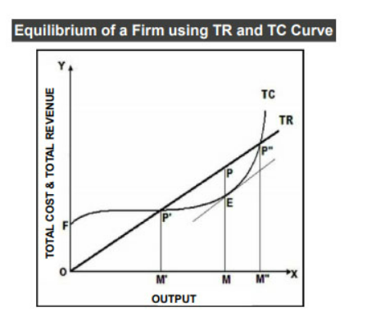
Total Revenue- Total Cost (TR-TC) Approach
According to this approach, the producer’s equilibrium has two conditions:
The difference between TR and TC is maximum.
2. Even if one more unit of output is produced, then the profit falls. In other words, the marginal cost becomes higher than the marginal revenue if one more unit is produced.
Notes:
In the figure above, the X-axis shows the levels of output and Y-axis shows total costs and total revenues. TC is the Total Cost Curve and TR is the Total Revenue Curve. Also, P is the equilibrium point where the distance between TR and TC is maximum.
Further, you can see that before the point P’ and after the point P”, TC>TR. Therefore, the producer must produce between P’P” or M’M”. At the point P, a tangent drawn to TC is parallel to TR. In other words, at point P, the slope of TC is equal to the slope of TR. This equality is not achieved at any other point.

Slide 28
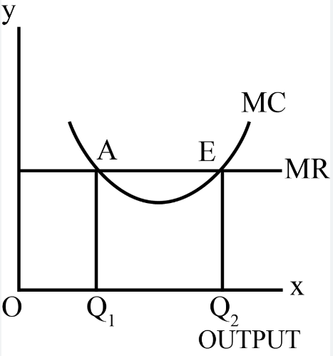
Marginal Revenue-Marginal Cost (MR-MC) Approach
The MR-MC approach is derived from the TR-TC approach. The two conditions of equilibrium under the MR-MC approach are:
1. MR = MC (necessary condition)
2. MC cuts the MR curve from below
Notes:
A firm is in equilibrium, i.e. maximizes profits, when it produces that quantity of output at which:
(1) MC = MR and
(2) MC becomes greater than MR if more output is produced
In the graph the equilibrium is at E and the equilibrium output is OQ2 . At point A also MC =MR but this is not equilibrium position because beyond A, MC is lower than MR. It is in the interest of the firm to produce more and add to profits. Therefore, only that output level at which MC= MR, and beyond which MC >MR, is the equilibrium.
MR = MC (necessary condition)
If one additional unit of the output is produced, then MR is the gain and MC is the cost to the producer. As long as MR is greater than MC, it is profitable to produce more. Therefore, the firm has not achieved an equilibrium level of output where the profit is maximum. This is because the firm can increase its profits by producing more.
On the other hand, if MR is less than MC, then the benefit is less than cost. Therefore, the producer is not in equilibrium either. He can reduce the production to add to his profits. When MC = MR, the benefit is equal to cost, the producer is in equilibrium provided that MC becomes greater than MR beyond this level of output.
Therefore, for producer’s equilibrium MC = MR is a necessary condition but not sufficient.
MC cuts the MR curve from below
While MC = MR is necessary for equilibrium but it is not sufficient. This is because the producer might face more than one MC = MR outputs. Out of these, only that output beyond which MC becomes greater than MR is the equilibrium output.
This is because if MC is greater than MR, then producing beyond MR = MC will reduce the profits. Also, when it is no longer possible to add profits, the maximum profit level is reached.
On the other hand, if MC is less than MR beyond the MC = MR output, then the producer can add profits by producing more. Therefore, for the producer’s equilibrium, it is important that MC = MR. Also, MC should be greater than MR if more output is produced.

Slide 29
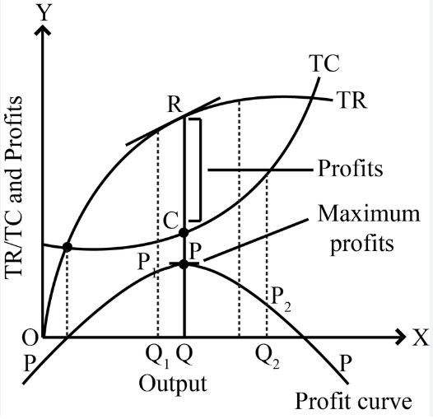
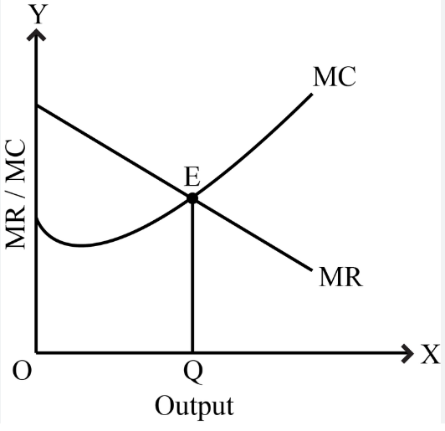
Producer Equilibrium: Imperfect Competition
Notes:
A producer is said to be in equilibrium when it is producing a level of output at which his profit is maximum. Profits are defined as the difference between total revenue (TR) and total cost (TC). Thus, Profit = TR - TC. Profits will be maximum when the difference between total revenue and total cost is maximum. The difference between total revenue and total cost is maximum at the level of output where the slope of TR curve = slope of TC curve. The diagram illustrates the equilibrium of a firm using TR and TC curves. In the diagram, TR represents total revenue curve and TC represents total cost curve. PP is the profit curve which is derived from the difference between TR and TC curve. A producer gets the maximum profits when he produces OQ units of output. If he produces OQ1 units, he earns P1Q1 as profit which is less than PQ and in case of OQ2 units, he earns only P2Q2 as profit. This too is less than the maximum profit (PQ).
In the diagram, MR curve will be downward sloping which shows to sell more output, the price has to be lowered. OQ is the equilibrium level of output because it also satisfies both the conditions of equilibrium, i.e., MC=MR and MC cuts MR from below.

Slide 30
Review Question
From the following total cost revenue schedule of a film, find out the level of output, using marginal cost and marginal revenue approach, at which the firm would be in equilibrium.
Output (units) | Total Revenue (Rupees) | Total Cost (Rupees)
1 | 10 | 8
2 | 18 | 15
3 | 24 | 21
4 | 28 | 25
5 | 30 | 33
Notes:
Calculate the Marginal Revenue and Marginal Cost. The firm would be at equilibrium position when it is producing 4 units of the commodity.

Slide 31

A market is any arrangement through which buyers and sellers of specific goods and services interact to possibly facilitate an exchange.
‘Market’ does not mean a particular place, but it means the entire area where buyers and sellers of a commodity are in such close contact with each other that price of the same commodity tends to be same throughout that area.
Notes:
A market is a place where parties can gather to facilitate the exchange of goods and services. The parties involved are usually buyers and sellers. The market may be physical, like a retail outlet, where people meet face-to-face, or virtual, like an online market, where there is no physical presence or contact between buyers and sellers.
It is a mechanism through which voluntary exchanges occur, facilitated by the forces of supply and demand. Markets can take various forms, including physical locations such as shops or online platforms.
Bringing People Together: The market is where buyers and sellers meet. Sellers have goods or services they want to sell, and buyers are looking to purchase those goods or services. It's like a big marketplace where everyone can find what they need.
Helping Us Decide: In the market, prices are set based on supply and demand. When lots of people want something but there's not much of it available, the price goes up. When there's plenty of something and not many people want it, the price goes down. These prices help us decide what to buy and how much to pay for it.
Encouraging Efficiency: Because prices are determined by supply and demand, the market encourages efficiency. Sellers want to make a profit, so they try to produce goods or services at the lowest possible cost. Buyers want the best value for their money, so they look for the best deal. This competition helps keep prices fair and encourages businesses to be efficient.
Supporting Innovation: In the market, businesses compete with each other to attract customers. To stand out, they often come up with new ideas, better products, or more efficient ways of doing things. This competition leads to innovation and helps drive progress in technology and society.
Creating Opportunities: The market provides opportunities for people to make a living. Whether it's selling goods, providing services, or investing in businesses, the market offers ways for individuals to earn money and support themselves and their families.
Fueling Economic Growth: A healthy market is essential for economic growth. When businesses thrive, they create jobs, invest in new projects, and contribute to overall prosperity. This benefits everyone in society by providing opportunities for employment, income, and a better standard of living.

Slide 32
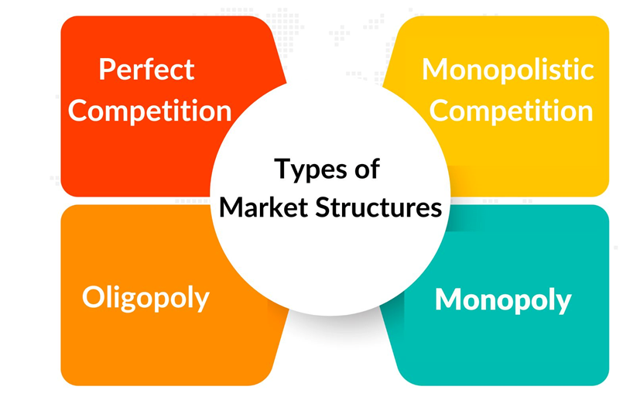
What is Market Structure?
It is the nature of degree of competition among firms operating in the same industry.
Market structures are the ways in in which the market places for specific products are grouped together.
It depends on number of firms, nature of products, firms behavior and extent of entry barriers.
Notes:
What is Market Structure?
In simple terms, market structure refers to how a particular market is organized and how companies within that market interact with each other and with consumers. It's like describing the "shape" of the market and the rules of the game that companies play by.
Here's a breakdown:
Number of Sellers and Buyers: How many companies are selling goods or services, and how many people are buying them? Are there just a few big players or lots of smaller ones?
Competition Level: How fiercely do these companies compete with each other? Do they have to keep prices low and quality high because there are many other options for consumers? Or do they have more control over prices because there aren't many alternatives?
Product Differentiation: Are the products or services being sold all very similar, or are they quite different from each other? Think of it like comparing generic brands of soda (very similar) to different brands with unique flavors and packaging.
Entry and Exit Barriers: How easy is it for new companies to enter the market and start selling their own goods or services? Are there high costs or regulations that make it difficult for newcomers to compete?
Control Over Prices: Do companies have a lot of control over how much they charge for their products, or are they more influenced by market forces like supply and demand?
These factors all play into how competitive a market is, how easy it is for new companies to enter, and ultimately, how prices and quality are determined for consumers. Different market structures can have different impacts on things like prices, innovation, and overall efficiency.

Slide 33
Market Structures
Perfect Competition
Many sellers
Oligopoly
Few Sellers
Monopoly
Single producer and seller
No close substitutes available
Monopolistic Competition
Large number of buyers and sellers
Homogenous products
Perfect substitutes available
Free entry and exit
Perfect knowledge and information
No advertising or product innovation
Differentiated products
Close substitutes available
Relatively free entry and exit
Non-price competition in the form of advertising and product innovation
Homogenous or differentiated products
Interdependent decision making
Substitutes may or may not be available
Very difficult entry and exit
Strategic pricing, output decisions and marketing efforts
Impossible entry (pure monopoly) or may face threat of potential entrants (contestable monopoly)
Usually regulated public utility (natural monopolies that produce essential goods)
Notes:
Types of Market Structures
1. Perfect Competition
Perfect competition occurs when there is a large number of small companies competing against each other. They sell similar products (homogeneous), lack price influence over the commodities, and are free to enter or exit the market.
Consumers in this type of market have full knowledge of the goods being sold. They are aware of the prices charged on them and the product branding. In the real world, the pure form of this type of market structure rarely exists. However, it is useful when comparing companies with similar features. This market is unrealistic as it faces some significant criticisms described below.
No incentive for innovation: In the real world, if competition exists and a company holds a dominant market share, there is a tendency to increase innovation to beat the competitors and maintain the status quo. However, in a perfectly competitive market, the profit margin is fixed, and sellers cannot increase prices, or they will lose their customers.
There are very few barriers to entry: Any company can enter the market and start selling the product. Therefore, incumbents must stay proactive to maintain market share.
2. Monopolistic Competition
Monopolistic competition refers to an imperfectly competitive market with the traits of both the monopoly and competitive market. Sellers compete among themselves and can differentiate their goods in terms of quality and branding to look different. In this type of competition, sellers consider the price charged by their competitors and ignore the impact of their own prices on their competition. When comparing monopolistic competition in the short term and long term, there are two distinct aspects that are observed. In the short term, the monopolistic company maximizes its profits and enjoys all the benefits as a monopoly.
The company initially produces many products as the demand is high. Therefore, its Marginal Revenue (MR) corresponds to its Marginal Cost (MC). However, MR diminishes over time as new companies enter the market with differentiated products affecting demand, leading to less profit.
3. Oligopoly
An oligopoly market consists of a small number of large companies that sell differentiated or identical products. Since there are few players in the market, their competitive strategies are dependent on each other.
When companies within the same industry work together to increase their mutual profits instead of competing doggedly with one another, it is known as an oligopoly situation.
For example, if one of the actors decides to reduce the price of its products, the action will trigger other actors to lower their prices, too. On the other hand, a price increase may influence others not to take any action in the anticipation consumers will opt for their products. Therefore, strategic planning by these types of players is a must.
In a situation where companies mutually compete, they may create agreements to share the market by restricting production, leading to supernormal profits. In such an agreement, they work like monopolies. The collusion is referred to as cartels.
4. Monopoly
In a monopoly market, a single company represents the whole industry. It has no competitor, and it is the sole seller of products in the entire market. This type of market is characterized by factors such as the sole claim to ownership of resources, patent and copyright, licenses issued by the government, or high initial setup costs.
All the above characteristics associated with monopoly restrict other companies from entering the market. The company, therefore, remains a single seller because it has the power to control the market and set prices for its goods

Slide 34
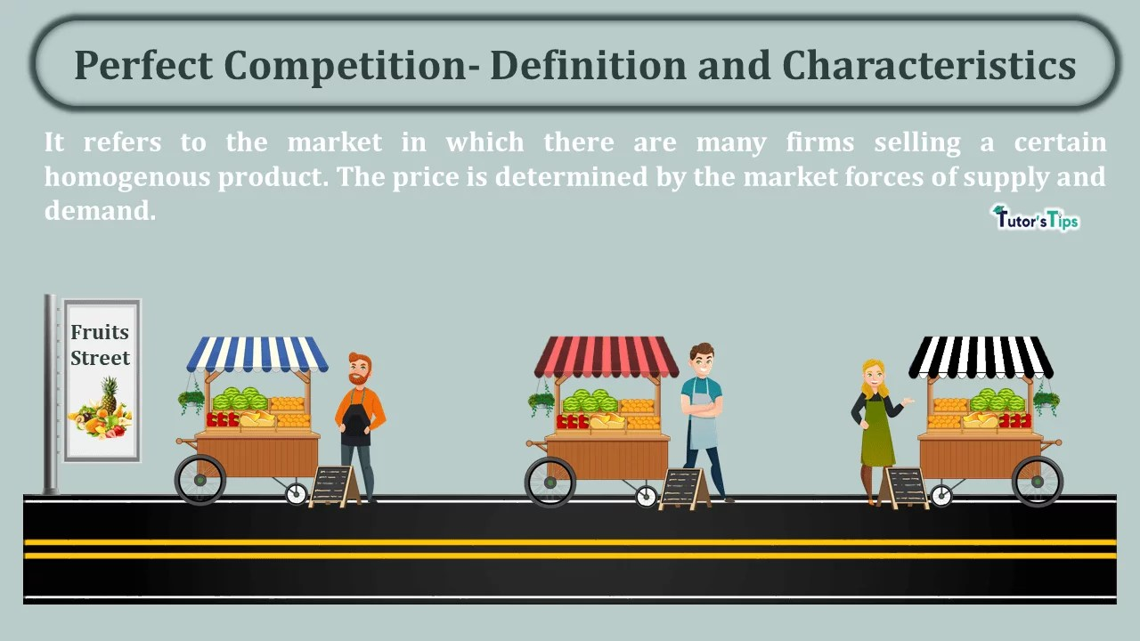
Perfect Competition
There are large number of firms producing and selling a product.
The product of all firms is homogenous.
Both the sellers and buyers have perfect information about the prevailing price in the market.
Entry into and exit from the industry is free for the firms.
Under perfect competition the transportation cost is considered to be negligible or immaterial .
The factors of production are perfectly mobile in perfect competition.
Absence of collusion between the firms.
Notes:
What is Perfect Competition
Perfect Competition is an uncommon phenomenon in the real business world. However, the actual market that approximates the conditions of perfectly competitive models includes foreign exchange market and local vegetable markets and agricultural product markets etc.
Although this form of market is an uncommon phenomenon, the perfectly competitive model has been the most popular model used in economic theories due to its analytical value as it provides a starting point and analytical framework for pricing theory.
In economic theory has a meaning diametrically opposite to the everyday use of this term. In practice, businessmen use the word competition as synonymous with rivalry. In theory, Perfect competition implies no rivalry among firms.
Features of Perfect Competition
These are some important features of perfect competition which are discussed below:
Large Number of Buyers and Sellers
Product Homogeneity
Free Entry and Exit of Firms
Perfect Mobility of Factors of Production
Perfect Knowledge
No Government Regulation
Absence of Transportation Costs
Profit Maximization
Absence of Collusion and Independent Decision Making by Firms
Features of Perfect Competition
Large Number of Buyers and Sellers
The industry or market includes a large number of firms (and buyers), so that each individual firm, however large, supplies only a small part of the total quantity offered in the market. So each firm alone can’t affect the price in the market by changing its output
Product Homogeneity
The industry is defined as a group of firms producing a homogeneous product. There is no way in which a buyer could differentiate between the products of different firms. So that price may not be distorted on the grounds of visible differences among the units of the same product.
Free Entry and Exit of Firms
There is no barrier to entry or exit from the industry. Entry or exit may take time, but firms have freedom of movement in and out of the Industry.
Perfect Mobility of Factors of Production
The factors of production are free to move from one firm to another throughout the economy. It is also assumed that workers can move between different a job, which implies that skills can be learned easily.
Perfect Knowledge
It is assumed that all sellers and buyers have complete knowledge of the conditions of the market. This knowledge refers not only to the prevailing conditions in the current period but in all future periods as well. Information is free and costless.
Under these conditions uncertainty about future development in the market is ruled out.
No Government Regulation
There is no government intervention in the market (tariffs, subsidies, rationing of production or demand and so on are ruled out. Most of the regulations are highly distortionary.
Absence of Transportation Costs
So that price may not get distorted by them in distant markets.
Profit Maximization
The goal of all firms is profit maximization. No other goals are pursued.
Absence of Collusion and Independent Decision Making by Firms
Perfect competition assumes that there is no collusion between the firms; they are not in the league between themselves in the form of a guide or cartel. Nor are the buyers in any kind of collusion between themselves. There is no consumer’s association.
This condition implies that buyers and sellers make their decisions independently and they act independently.

Slide 35
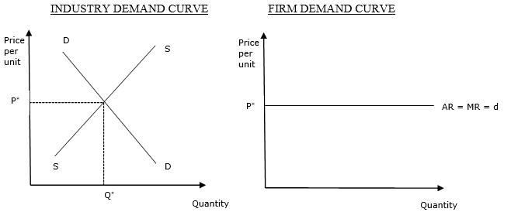
Perfect Competition : Demand Curve
Notes:
As there are a very large number of buyers and sellers under perfect competition, every firm is a price-taker. It means that no single firm has the ability to influence the price of a product in the market, and has to therefore sell the product at the price determined by the industry. It is so because the share of firms under perfect competition in the total market supply is negligible.
A firm is different from an industry. A firm is a single unit producing or providing the market with goods and services. However, an industry is the total of all the firms manufacturing the same goods in the market. For example, Cadbury is a chocolate manufacturing firm, which comes under the chocolate industry with other firms producing chocolates.
Hence, it can be concluded that a firm does not play any role in the price determination of a product, as it can neither affect the supply of a product nor it can affect its demand in the market. Therefore, a firm is a Price-Taker and an industry is a Price-Maker. The price of a product is determined by the industry at the point where the market demand curve and supply curve of the product meets, and every firm has to sell their product at this price only. This concept can be understood with the help of a graphical representation.
In the above graph, the market demand for a product is shown by the DD curve and its supply is shown by the SS curve. The DD curve and SS curve intersect with each other at Price P* and Quantity Q*, which means that the price determined by the industry through demand and supply of the product is P*. This price is adopted by the price taker firms, and they are free to sell any unit of quantity OQ, OQ_{1,} etc., at this price. It means that the AR curve of the product becomes perfectly elastic and parallel to the X-axis. Besides, when AR remains constant, it becomes equal to MR (AR = MR).

Slide 36
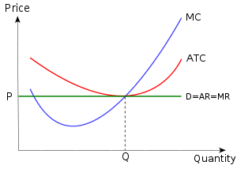
Firm’s Equilibrium under Perfect Competition
Notes:
In perfect competition, firms achieve minimum average total cost (ATC) due to the following characteristics of the market structure:
Price-taking Behavior: In perfect competition, firms are price takers, meaning they cannot influence the market price of the product they sell. Instead, they must accept the prevailing market price as given. Since the market price equals both marginal revenue (MR) and average revenue (AR) for each firm in perfect competition, firms maximize profits by producing at the level where marginal cost (MC) equals marginal revenue (MR), which is also equal to the market price.
Profit Maximization: Firms in perfect competition aim to maximize profits, which occurs at the level of output where marginal cost equals marginal revenue. At this point, the firm produces the quantity of output where the additional revenue from selling one more unit (MR) is equal to the additional cost of producing one more unit (MC). This condition ensures that the firm is allocating resources efficiently and maximizing its net income.
Long-Run Equilibrium: In the long run, firms in perfect competition adjust their production levels to achieve minimum average total cost (ATC) and earn normal profits. If a firm's ATC is above the market price in the long run, it will experience losses and exit the industry. Conversely, if a firm's ATC is below the market price, new firms will enter the industry, increasing competition and driving down prices until firms earn only normal profits.
Economies of Scale: Perfectly competitive firms operate at the minimum efficient scale (MES) where average cost is being minimized, where they produce at the lowest possible average total cost given the scale of production. This occurs when firms fully exploit economies of scale, such as specialization, division of labor, and efficient utilization of resources. Operating at MES allows firms to minimize their per-unit costs and maximize efficiency.
Allocative Efficiency: In perfect competition, firms produce at the quantity where price equals marginal cost (P = MC), ensuring allocative efficiency. This means that resources are allocated to their most valued uses, and the economy achieves the highest possible level of consumer satisfaction. At the same time, firms operate at the lowest possible average total cost, ensuring productive efficiency.
Overall, in perfect competition, firms achieve minimum average total cost by producing at the level where marginal cost equals marginal revenue (which equals market price), operating at the minimum efficient scale, and maximizing allocative (because ATC is minimized) and productive efficiency (because MR=MC). This equilibrium condition ensures that firms are maximizing profits and utilizing resources optimally in the long run.

Slide 37
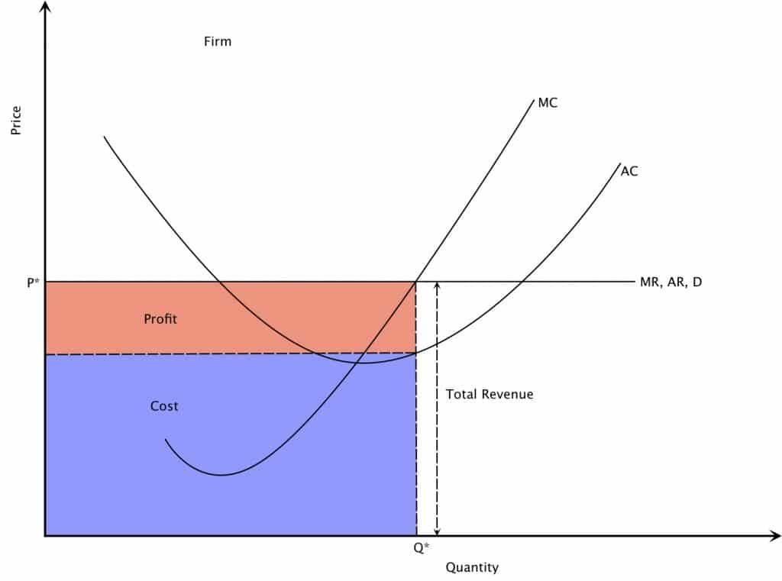
Perfect Competition: Normal vs Supernormal profit
1. Normal Profit: Normal profit refers to the level of profit necessary to keep a firm in its current line of business. In perfect competition, normal profit occurs when a firm's total revenue just equals its total costs.
2. Supernormal profit: It is also known as economic profit, occurs when a firm's total revenue exceeds its total costs
Notes:
In micro economic theory, there is a term called supernormal profit. The term itself defines what it is — profit above the normal level.The superlative "super" merely adds to there being a windfall profit.
Another definition of supernormal profit is all the excess profit a company makes above the minimum return necessary to keep a company in business.
Conversely, normal profit is defined as the minimum level of profit necessary to keep a company in that line of business. This level of normal profit enables the company to pay a reasonable salary to its workers and managers. It is, in short, the normal profit earned by a company.
Thus, supernormal profit is defined as extra profit above that level of normal profit. The challenge with earning supernormal profit is that it provides an incentive for other companies to enter the industry. And they can enter the industry easily if the barriers to entry are low.
Supernormal profit in perfect competition
The theory of perfect competition suggests that supernormal profit can only be earned in the short term. In the long term, firms will make normal profits. This is because other entrants will increase supply and erode the supernormal profit. With perfect competition, there will be two things: freedom of entry and exit, and perfect information.
A good example in recent times is the supernormal profit enjoyed by glove companies when the Covid-19 pandemic raged and ravished health and lives. There was a sudden and huge increase in demand for gloves, but supply was rather limited.
Basic economic theory states that when demand outstrips supply, prices will increase, and prices did increase in the form of increased ASP (average selling price) of gloves.
The supernormal profit enjoyed by the glove companies must have been the envy of many other companies both locally and internationally. Locally, a few public-listed companies announced their venture into the glove business. This announcement alone drove their share prices up. Internationally, China was getting ready to flex its muscles and flood the market with gloves given their availability of human resources and their enviable time-to-market.
They were prepared to undercut mercilessly — and so they did.
Malaysian glove companies suffered as a result. Their supernormal profits were whittled away to normal profits.
All glove companies ended up being punished with below supernormal profits. Some smaller players have sunk into the red recently.
There is one factor that contributed to the rapid levelling of supernormal profits —low barriers to entry. It is estimated that it takes as short as six months to set up and operationalize glove production lines. Additionally, rubber gloves are a commodity business (easy to copy) with little to no differentiation. With more new players joining the fray and existing players also expanding production capacity, supply eventually outstripped demand and resulted in rapid declines in the ASP.
Contrast this with the situation faced by palm oil companies. Large-scale plantation land is scarce and it takes about three years for a freshly planted oil palm to yield FFBs (fresh fruit bunches).
However, the yield is relatively low at this stage and remains so until year seven. It is only at year seven that the tree reaches peak production. The barriers to entry are higher here and the gestation periods are longer.
However, most markets don't have these features of perfect information and freedom of entry and exit.
Most markets have a degree of barriers to entry and exit. There are set-up costs that deter entry. Therefore, even if firms are making supernormal profit, new firms may not be able to enter and compete as the set-up cost is simply too overwhelming.
Pros and cons of supernormal profit
The pros are:
• Firms can use supernormal profit to invest in research and development and enhance its first-mover advantages through better innovation.
• Governments can collect windfall tax from the supernormal profit. But this can be a con, depending on which side of the equation you stand.
• Enables firms to build up reserves to survive economic downturn — the "war chest". Acquisitions, mergers and diversification become a possibility.
• Potential special dividends to reward shareholders.
The cons are:
• If supernormal profit is gained from monopoly power, it represents a transfer of income from consumers to owners of monopolies. This is allocatively inefficient.
• Very profitable firms like Apple and Google often have difficulty to usefully reinvest profit. Hence, they develop large cash reserves, representing unused resources.
So, the vulnerability of supernormal profit can be due to barriers of entry or how easily competitors can enter the industry.
According to investment guru Warren Buffett, this is the "moat" that discourages new entrants into a particular industry and by extension, protects companies in that industry.

Slide 38
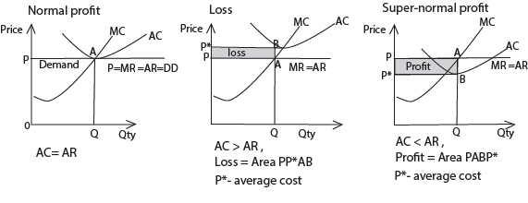
Perfect Competition: Short-Run Equilibrium
Notes:
Equilibrium is attained when MC= MR=AR and MC curve cuts the MR curve from below.
Three possibilities: Normal profit (MC = MR = AR =AC= DD = P); Loss ( AC > AR) and super-normal profit (AC < AR) as shown in diagram below

Slide 39
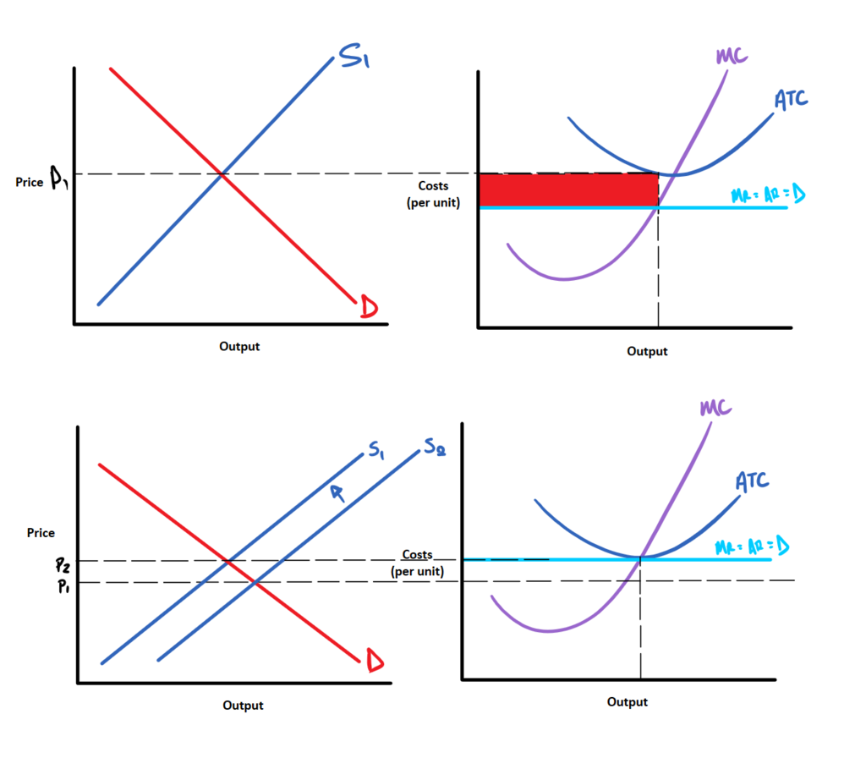
Perfect Competition: Long-Run Equilibrium
1. The availability of economic profits will attract new firms to the jacket industry in the long run, shifting the market supply curve to the right. Entry will continue until economic profits are eliminated. The price will fall.
2. In long-run equilibrium in a perfectly competitive industry firms will earn zero economic profit.

Slide 40
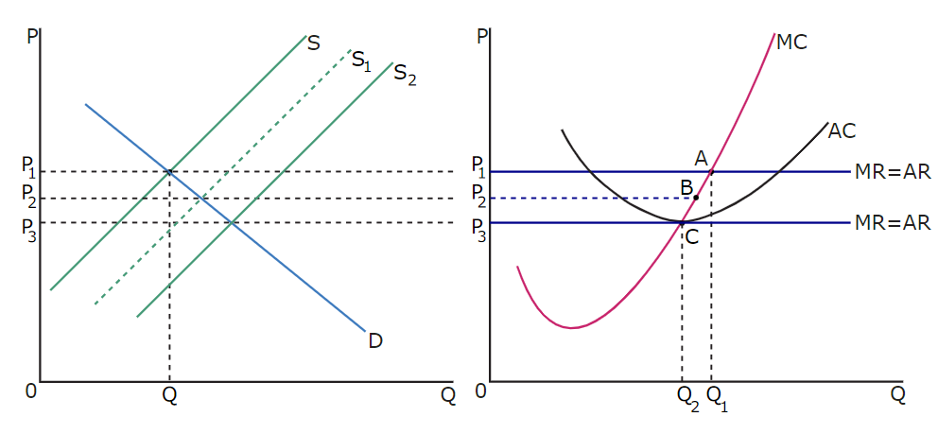
Long-run Equilibrium of Firms
Notes:
When existing firms are making an economic profit, it will attract new firms wishing to enter the market. As more firms enter the market, the market supply increases and the equilibrium price decreases. This process will continue until firms are only making a normal profit.
This can be illustrated by the following diagrams:
The market is represented in left-hand side diagram , while the individual firm is represented in right- hand diagram .
At a market price of P1, the firm is making an economic profit as the average revenue is greater than the average cost. This is indicated by point A. The economic profit attracts firms to enter the market, and the market supply curve thus shifts to the right, and the market equilibrium price decreases to P2. As the market equilibrium price decreases, the firm's economic profit declines, as indicated by point B. This process of an increase in the number of new entrants, an increase in the market supply and a decrease in market equilibrium price continues until point C is reached, where only normal profits are earned. Thus, in the perfectly competitive market, long-run equilibrium will only be achieved once all firms are earning normal profits.

Slide 41
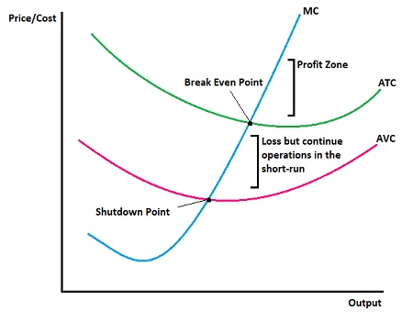
Perfect Competition: Shutdown Point
A firm reaches shutdown point when AR=AVC.
2. When a firm is able to cover its variable costs only, it will be at shut-down point. At shut-down point, the firm no longer gets benefits from its operations.
Notes:
Short-run shutdown point: A firm should shut down in the short run if it cannot cover its variable costs. In other words, if the total revenue (TR) is less than the variable costs (VC), the firm should shut down. This is because even if the firm continues to produce and cover some of its fixed costs, it would be better off shutting down and minimizing its losses equal to the fixed costs.
Long-run shutdown point: In the long run, firms should exit the industry if they cannot cover their total costs, including both fixed and variable costs. In a perfectly competitive market, firms enter or exit until economic profit is driven to zero. So, the long-run shutdown point is where TR equals TC, including both fixed and variable costs. If TR is less than TC in the long run, the firm should exit the industry.

Slide 42
Review Question
Q: Firms in a perfectly competitive market are said to be price takers—that is, once the market determines an equilibrium price for the product, firms must accept this price. If you sell a product in a perfectly competitive market, but you are not happy with its price, would you raise the price, even by a rupee?
Notes:
No, you would not raise the price. Your product is exactly the same as the product of the many other firms in the market. If your price is greater than that of your competitors, then your customers would switch to them and stop buying from you. You would lose all your sales.

Slide 43
Review Question
Q: Would independent trucking fit the characteristics of a perfectly competitive industry?
Notes:
Possibly. Independent truckers are by definition small and numerous. All that is required to get into the business is a truck—not an inexpensive asset, though—and a commercial driver’s license. To exit, one need only sell the truck. All trucks are essentially the same, providing transportation from point A to point B—assuming we're not talking about specialized trucks. Independent truckers must take the going rate for their service, so independent trucking does seem to have most of the characteristics of perfect competition.

